Slide 1











Notes:
DO NOT UNHIDE THIS SLIDE. There is an action button on the title slide to activate the waiting slide.
Waiting Slide. This is the slide displayed until everyone is ready for the presentation. Use it as a background to do some small talk, roundtable, wait for participants to arrive.
TO START THE PRESENTATION, click esc.

Slide 2

Knowledge management
Starter Pack Training Material
Notes:
Click on the Apptio Logo to launch the hidden Waiting Slide.

Slide 3
INTRODUCTION

Slide 4
AGENDA
Knowledge Management in ITIL v3
ServiceNow Overview
Knowledge process

Slide 5
WHAT IS KNOWLEDGE MANAGEMENT?
Definition:
The Process responsible for gathering, analysing, storing and sharing knowledge and information within an Organisation.
The goals of the ITIL knowledge Management process are to manage knowledge and information and to improve efficiency by reducing the need to rediscover knowledge. It presents all information that an IT service provider needs to manage the full lifecycle of IT Services.
Meant to manage information and reducing the need to rediscover knowledge:
Information is easily searchable
Every user should have access to the appropriate knowledge content.
An Article is usually handled by the associated Owner Group

Slide 6
Process flow
New KB Submission
Technical review
Invalid or duplicated
Submission
Close as duplicate or duplicate
Editorial review
(Re-) Publish article
Published article
Review KB Article
Archive KB Article
KB Article in review status
Closed KB Submission
Retired KB Article

Slide 7
Servicenow overview

Slide 8
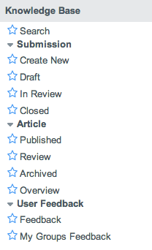
APPLICATION & MODULES
Access to the Knowledge Homepage
Access to a blank KB Submission form
List of Submissions records with status “Draft”
List of Submissions records with status “Technical review” or “Functional review”
List of feedback posted for an article owned by my groups
1
2
3
4
5

Slide 9
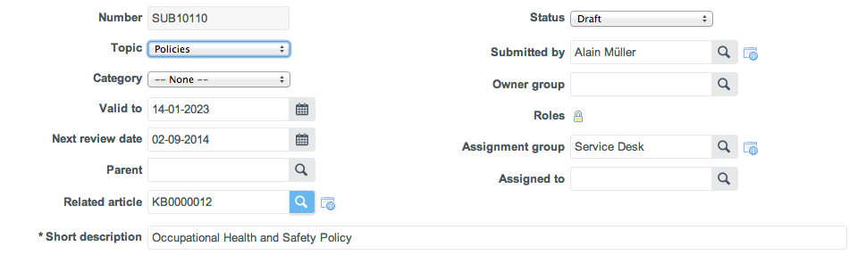
KB Submission FORM & FIELDS
1
a
2
b
3
4
c
5
d
6
e
7
f
Submission Number
Topic to which the Submission relates to
Category to which the submission relates to
Date until when the article will be valid
Date when you will have to review the article
Task where the submission can come from
Article from which the submission has been created from (when reviewing already published article
Submission status
Submitter identification
Roles that can view the articles
KB Submission assigned group
KB Submission assigned person
KB Article title
(Orange= automated fields)

Slide 10
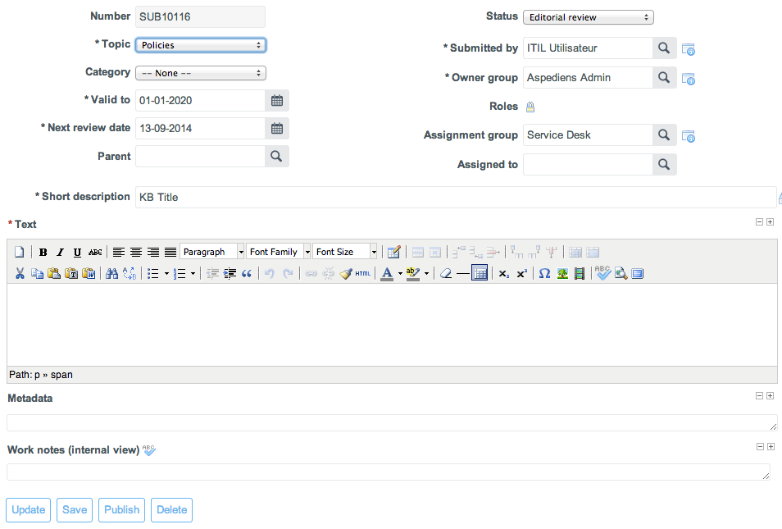
ACTIONS BUTTONS & TEXT FIELDS
1
2
3
4
Save the submission and go back to the list
Save the submission and remain on the record
Publish the submission (turn it into a knowledge base article)
Add attachments to the record (Attachments will be available on the KB Article on publication)
Enter the content of the submission
Keywords on which the Article should appear when searched
Work notes field used for internal communications
a
b
c

Slide 11
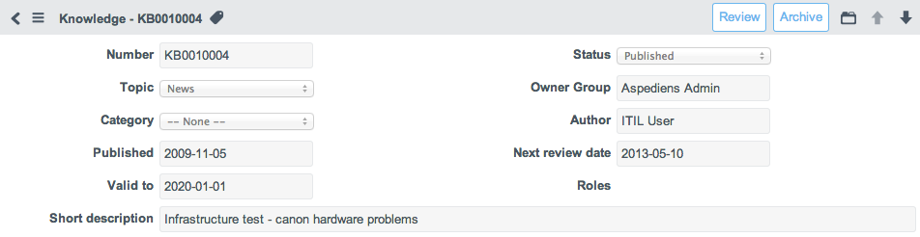
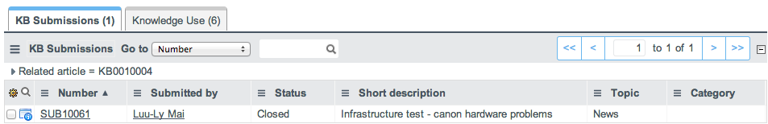
KB Article Form
a
c
b
A KB Article has the same attributes and content as its originating KB Submission.
These may not be modified unless the Article is reviewed (a new KB Submission is then created).
Review article: the article is set in “Review” state and a new KB Submission related to this Article is created
Related KB Submissions can be found in the “KB Submissions” related list
Archive article: the article is set in “Retired” state

Slide 12
Knowledge process

Slide 13
CREATING A KB SUBMISSION
In order to create a KB Article, a KB Submission needs to be submitted.
Step | In ServiceNow
1. Create a submission | “Knowledge Base” > “Create New”
2. Choose the appropriate topic and category | Set the appropriate values in the “Topic” and “Category” fields.
3. Provide a KB Article Title | Update the “Short description” field
4. Document the content of the KB Article | Enter the full details of the desired article in the “Text” section. Key words for KB searches can be added into the Metadata field.
5. Assign to appropriate group | Search and Select the appropriate “Assignment Group” and “Assigned to”  Email notification sent to the group or assignee
6. Save the submission | Click on “Update” or “Save”  Email notification sent to submitter

Slide 14
REVIEWING A KB SUBMISSION
Assigned people should review the submission on a technical and editorial basis.
Step | In ServiceNow
1. Update the submission status | Change “Status” from “Draft” > “Technical review” or “Editorial review”
2. Verify topic and category | Verify accuracy of selected “Topic” and “Category”
3. Verify text and metadata | Verify accuracy of associated “Text” and metadata key words.
5. Communicate on work performed on the submission | Update “Work notes” with all activity and comments  Email notification sent to the group or assignee
6. Save the submission | Click on “Update” or “Save”

Slide 15
PUBLISHING A KB SUBMISSION
After a submission has been reviewed, a user with knowledge role can publish it as an article
Step | In ServiceNow
1. Make the submission ready for publication | Set the status of the KB Submission to « Editorial review »
2. Define an Owner group | Search and select the appropriate owner group
3. Restrict KB Article to specific population | Add roles if the article has to be restricted to specific roles
4. Preview article | Make a right click on the submission header and select “Preview” in order to check the content display of the future article.
5. Provide necessary validity data | Confirm that the “Valid to” and “Next review date” are correct
6. Save the submission | Click on “Update” or “Save”  Email notification sent to the group
7. Publish the submission | A user with the knowledge role will have the “Publish” or “Re-publish” button on top of the submission
When an article is published, it can be search in the KB, but at any moment a knowledge ITIL user can review it. And any reader can post a feedback. Email notification sent to the article author and group assigned

Slide 16
CLOSE A KB SUBMISSION WITHOUT PUBLISHING IT
Step | In ServiceNow
1. Close the submission | Change status to “Closed”
2. Set the close code | Choose the appropriate “Close code”  Email notification sent to submitter
Close code | Description
Duplicate | An article already exist
Invalid | The submission is not correct, functionally or technically

Slide 17
Review and archival of Published KB Article
In order to modify the content of a Published KB Article, this latter needs to be reviewed and then re-published.
Step | In ServiceNow
1. Review KB Article / Create a new KB Submission | Open KB Article and click on “Review” button.  The KB Article is set into “Review” state and a related KB Submission with the same content as in the originating KB Article.
2. Review content | Proceed with the KB Submission content review as in the normal KB Submission process
3. Re-publish article | Once technical and editoral review is completed, click on “Republish” in order to update the originating Article with the latest content and set its status to “Published”
In order to archive a published KB Article, click on the “Archive” button on the KB Article record.
The KB Article status will be set to “Retired” and the Article will no longer be visible in the Knowledge base.

Slide 18
NOTIFICATIONS
External notification (Caller)
Name | Recipient | Trigger
New submission | Submitter | KB Submission inserted
Submission closed | Submitter | KB Submission invalid or duplicate
Submission published | Submitter and Owner group | KB Article created
Internal notifications (Assignee or group)
Name | Recipient | Trigger
Submission assigned | Sent to the Assignee or Owner Group | Submission assigned to a group and/or assignee.
Submission commented | Sent to article’s Author or Owner Group | Feedback about the article added
Work note added | Sent to the Assignee to or Owner Group | Work notes added.

Slide 19
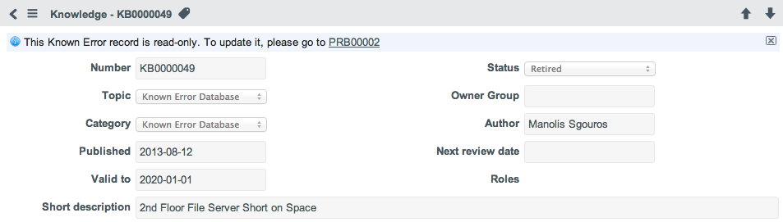
Known error database
Known Error Database is a Topic and Category within the Knowledge base which contains articles related to Problems marked as “Known Errors”.
Known Error KB Articles are fully managed via the Problem Management process:
Known Error KB Articles can only be created from Known Error Problem records.
Known Error KB Articles can only modified by updating the related Known Error Problem records (Known Error Description and Workaround fields).
Publication or archival of Known Error KB Articles is based on the “Known Error” flag on the related Problem records.

Slide 20
EXERCISE 1 – CREATE NEW SUBMISSION
Log a new submission as an ITIL user
Log in as ITIL User
Topic: “Desktop”
Short description : “How to configure Outlook 2003”
Text : Populate with a full text using format and image
Assignment group : “Software”
Submit

Slide 21
EXERCISE 2 – PUBLISH AN ARTICLE
As ITIL Manager review the KB Submission
Log in as ITIL Manager
Open submission created previously
Check “Text”, “Topic” and “Owner group”
Populate some “Metadata” and “Work notes”
Publish article

Slide 22
THANK YOU

